Slide 1



Seven Years in the Life of Hypergiants’ Off-nets
Petros Gigis¹
Matt Calder^{2,3}, Lefteris Manassakis⁴, George Nomikos^{4,5}, Vasileios Kotronis⁴,
Xenofontas Dimitropoulos^{4,6}, Ethan Katz-Bassett³, Georgios Smaragdakis⁷
¹ University College London, ² Microsoft, ³ Columbia University,
⁴ FORTH-ICS, ⁵ Lancaster University, ⁶ University of Crete, ⁷ TU Delft
ACM SIGCOMM, August 2021

Slide 2
Hypergiants and Traffic Consolidation
January 2009 - 2019
In 2019, 5 sites contribute 50% of traffic!
In 2016, 10 of ASes contribute 50% of traffic!
In 2009, 150 of ASes contribute 50% of traffic!
In 2007, 1,000s of ASes contribute 50% of traffic
2000 ASN == 50%
2007
150 ASN == 50%
2009
5 HG == 50%
2019
Source: Internet Traffic 2009-2019, C. Labovitz.
2

Slide 3
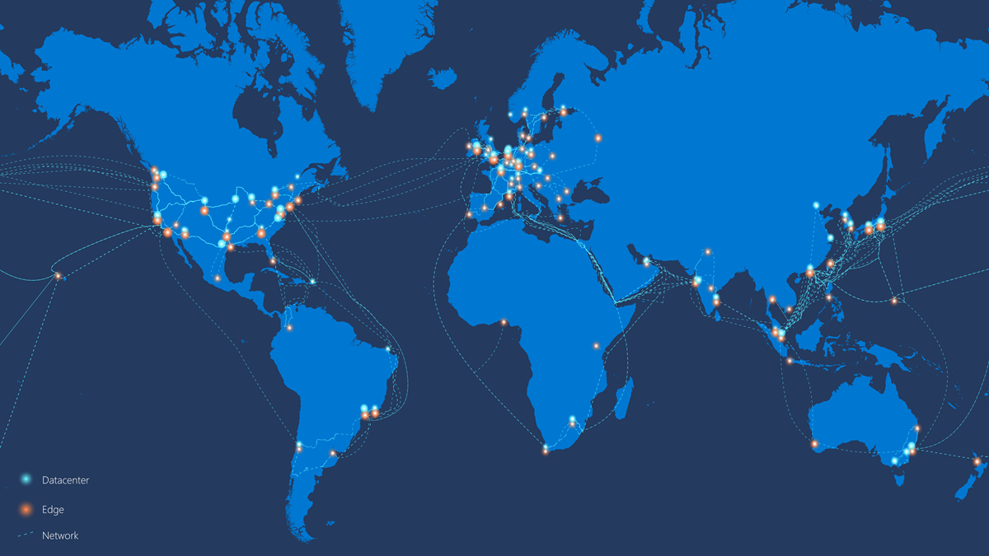
Microsoft’s Azure Global Network
Peer at IXPs and
collocation facilities
Construct datacenters
Deploy off-net servers
Peer directly
with eyeballs
Roll out fiber to
built their backbone
Source: Microsoft (January 2020)
3

Slide 4



Hypergiant’s off-net footprint
Hypergiant AS(es)
ISP AS
Server-to-Server
connection
End User
Hypergiant
on-net server
Hypergiant
off-net Server
AS-level peering
On-net: A server deployment
inside the HG own network.
Off-net: A server deployment
outside of the HG own network.
4

Slide 5


Why measure Hypergiant’s Off-nets?
HG
Peering link
ISP
Revisit the value of peering and how traffic flows in the Internet.
Understand the evolution of the Internet structure.
Localisation of content within an Internet Service Provider (ISP).
Performance potential for emerging networks (e.g., ).
5

Slide 6
How to measure Hypergiant’s Off-nets?
Traditional techniques (e.g., IP-to-AS mapping) do not work.
Existing approaches^{[1.2]} to discover off-nets lack generality and are fragile to HG changes. [1] “Mapping the Expansion of Google’s Serving Infrastructure”, Calder et. al., IMC 2013 [2] “Open Connect Everywhere: A Glimpse at the Internet Ecosystem through the Lens of the Netflix CDN”, Böttger et. al., CCR 48
So, is there a generic method to uncover the off-nets of all Hypergiants?
Surprisingly, yes!
6

Slide 7
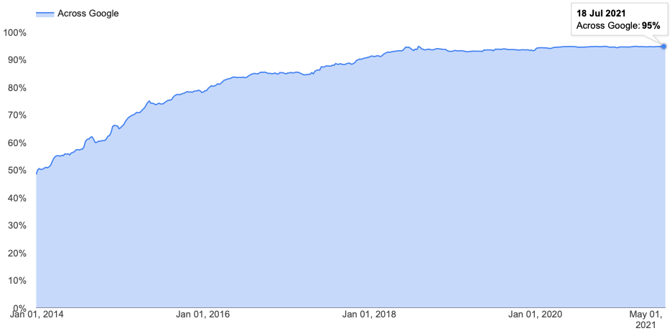
Encrypted traffic is the new standard
The majority of the traffic is encrypted.
Enabling change: encrypted traffic is the new standard
Using TLS certificates we can find the service owner.
Corpuses of TLS data are publicly available.
Source: Google Transparency Report
7

Slide 8



Contributions
We developed the first technique capable of uncovering the off-net footprint deployment of all Hypergiants.
We applied it to map their growth from 2013 to 2021.
We found that grew by 2,766 ASes, reaching 3,810 in April 2021.
and launched their own CDNs and now have presence in at least 2,115 ASes.
8

Slide 9
What this work is not about:
Not a head-to-head comparison of different HGs as we do not know:
Business strategies.
Peering agreements.
Performance and cost goals.
Performance evaluation of different HG off-net footprints is out of the scope of this work.
In this work, we focus only on uncovering the off-net deployments.
9

Slide 10



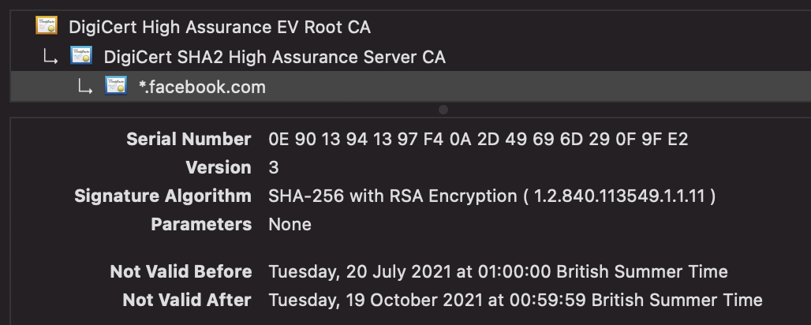
Methodology
Step 0: Collect TLS certificates dataset
Step 1: Validate Certificates
Exclude self-signed, expired and certificates with a non-verified chain.
Valid TLS Certificates
TLS Certificates Dataset
10

Slide 11



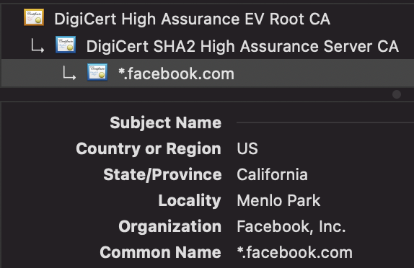
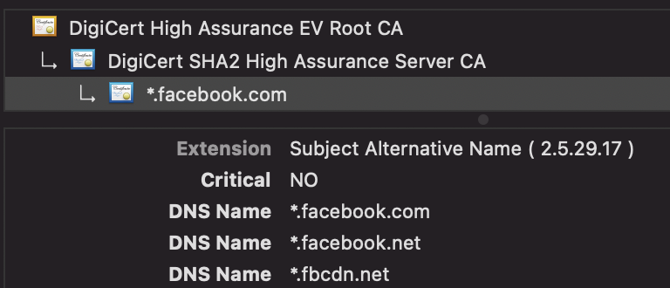
Methodology
Step 2: Learn Hypergiant TLS Fingerprints
Input the HG keyword e.g., “facebook” and the TLS scans for all on-net IPs.
Facebook AS(es)
On-net TLS
Fingerprints
Valid TLS Certificates
11

Slide 12
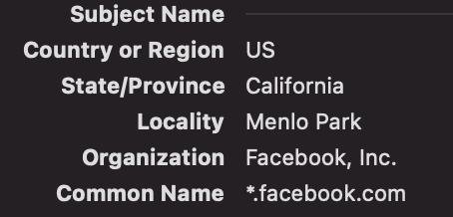

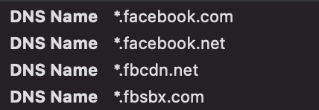
Methodology
Step 3: Use Fingerprints to Identify candidate off-nets
Search for certificates matching the on-net fingerprints.
AS1
AS3
On-net TLS
Fingerprints
Candidate off-net
server deployments
AS2
12

Slide 13


Challenges
Does presence of a Hypergiant certificate on a server outside their own network guarantee that the server is an off-net server deployment?
No, it does not!
off-nets
AS(es)
The server is owned by Akamai
and used by Facebook
Akam. off-net servers used by Facebook
13

Slide 14


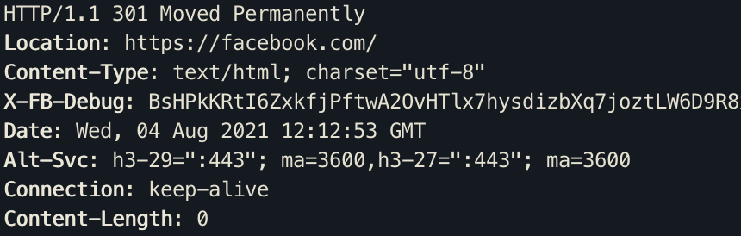
Methodology
Step 4: Learn Hypergiant HTTP(S) Fingerprints using headers
GET HTTP (80)
HTTP header
Fingerprint
AS2
AS3
HTTPS header
Fingerprint
GET HTTPS (443)
AS1
14

Slide 15

Methodology
Step 5: Confirm Candidates Using HTTP(S)
Apply the HTTP(S) fingerprints to the off-net candidates and classify as off-nets any that match the HG fingerprints.
HTTP header
Fingerprint
Candidate off-net
server deployments
Off-net
server deployments
HTTPS header
Fingerprint
15

Slide 16
Technique Outline
The TLS certificate reveals if an IP hosts a service for the Hypergiant.
HTTP(S) header reveals who operates the server.
The IP address reveals if it is an on-net or off-net server.
To consider a server as a Hypergiant off-net deployment:
TLS certificate and HTTP(S) headers must map to the Hypergiant.
The IP address is not part of the Hypergiant own network.
16

Slide 17

Datasets
TLS certificate scans:
collects certificates in IPv4-wide scans on port 443.
Quarterly snapshot from Oct. 2013 to Apr. 2021.
HTTP(S) headers (Validation):
We used corpuses of available HTTP(S) headers from Rapid7 from Oct. 2013 to Apr. 2021.
17

Slide 18
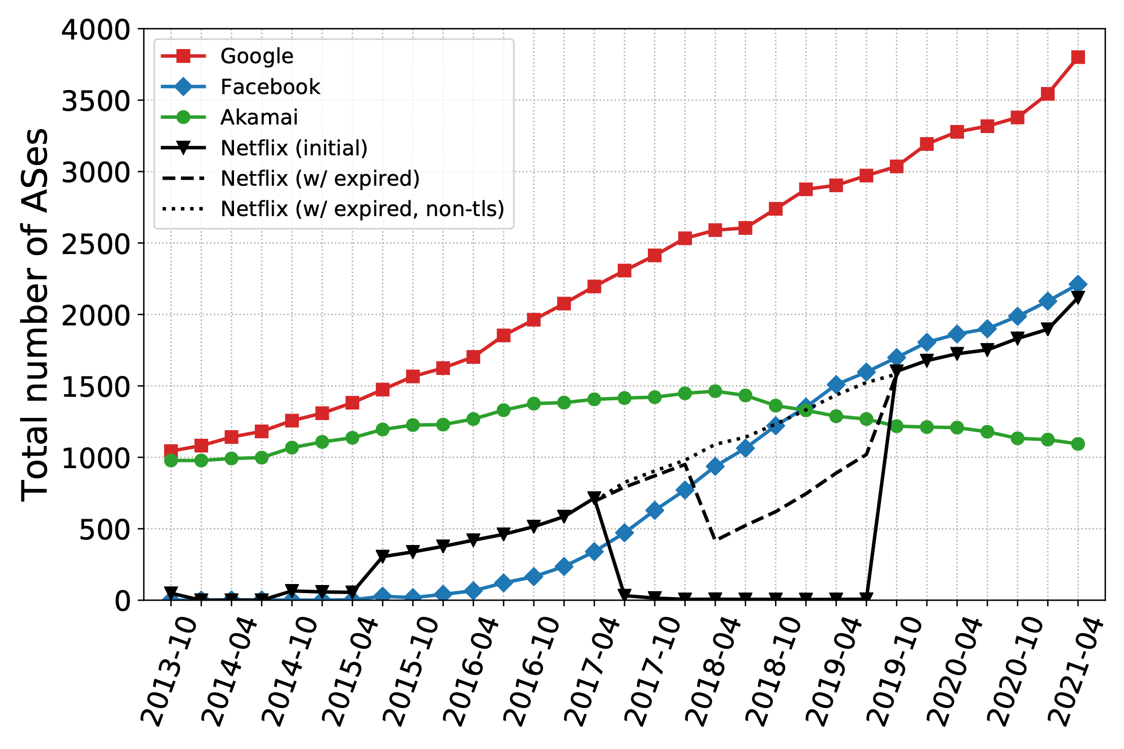
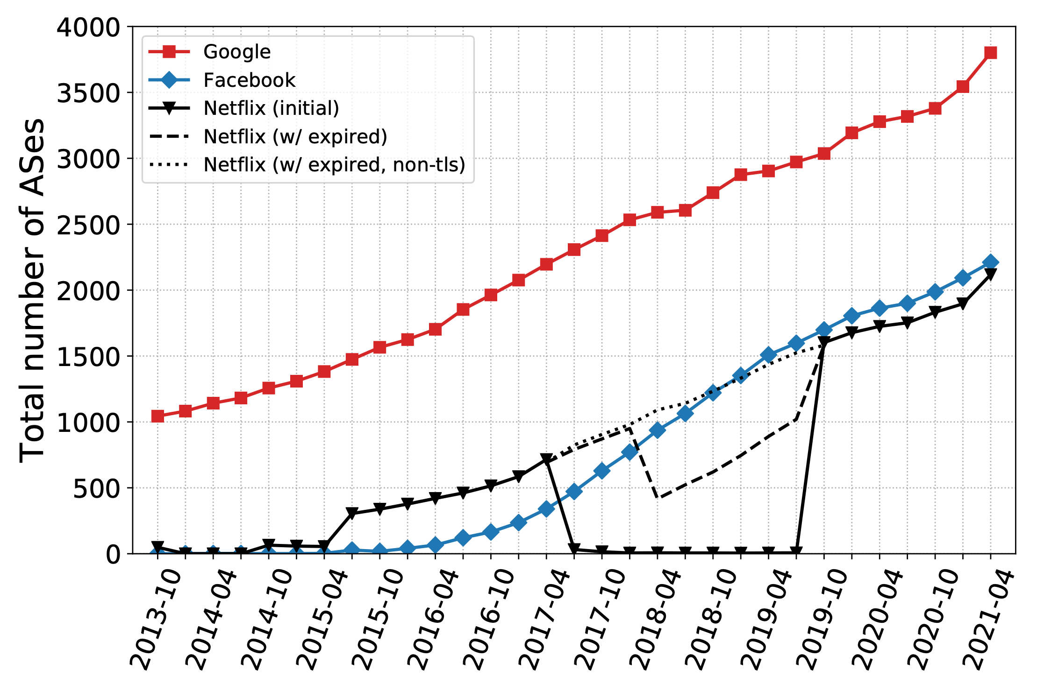
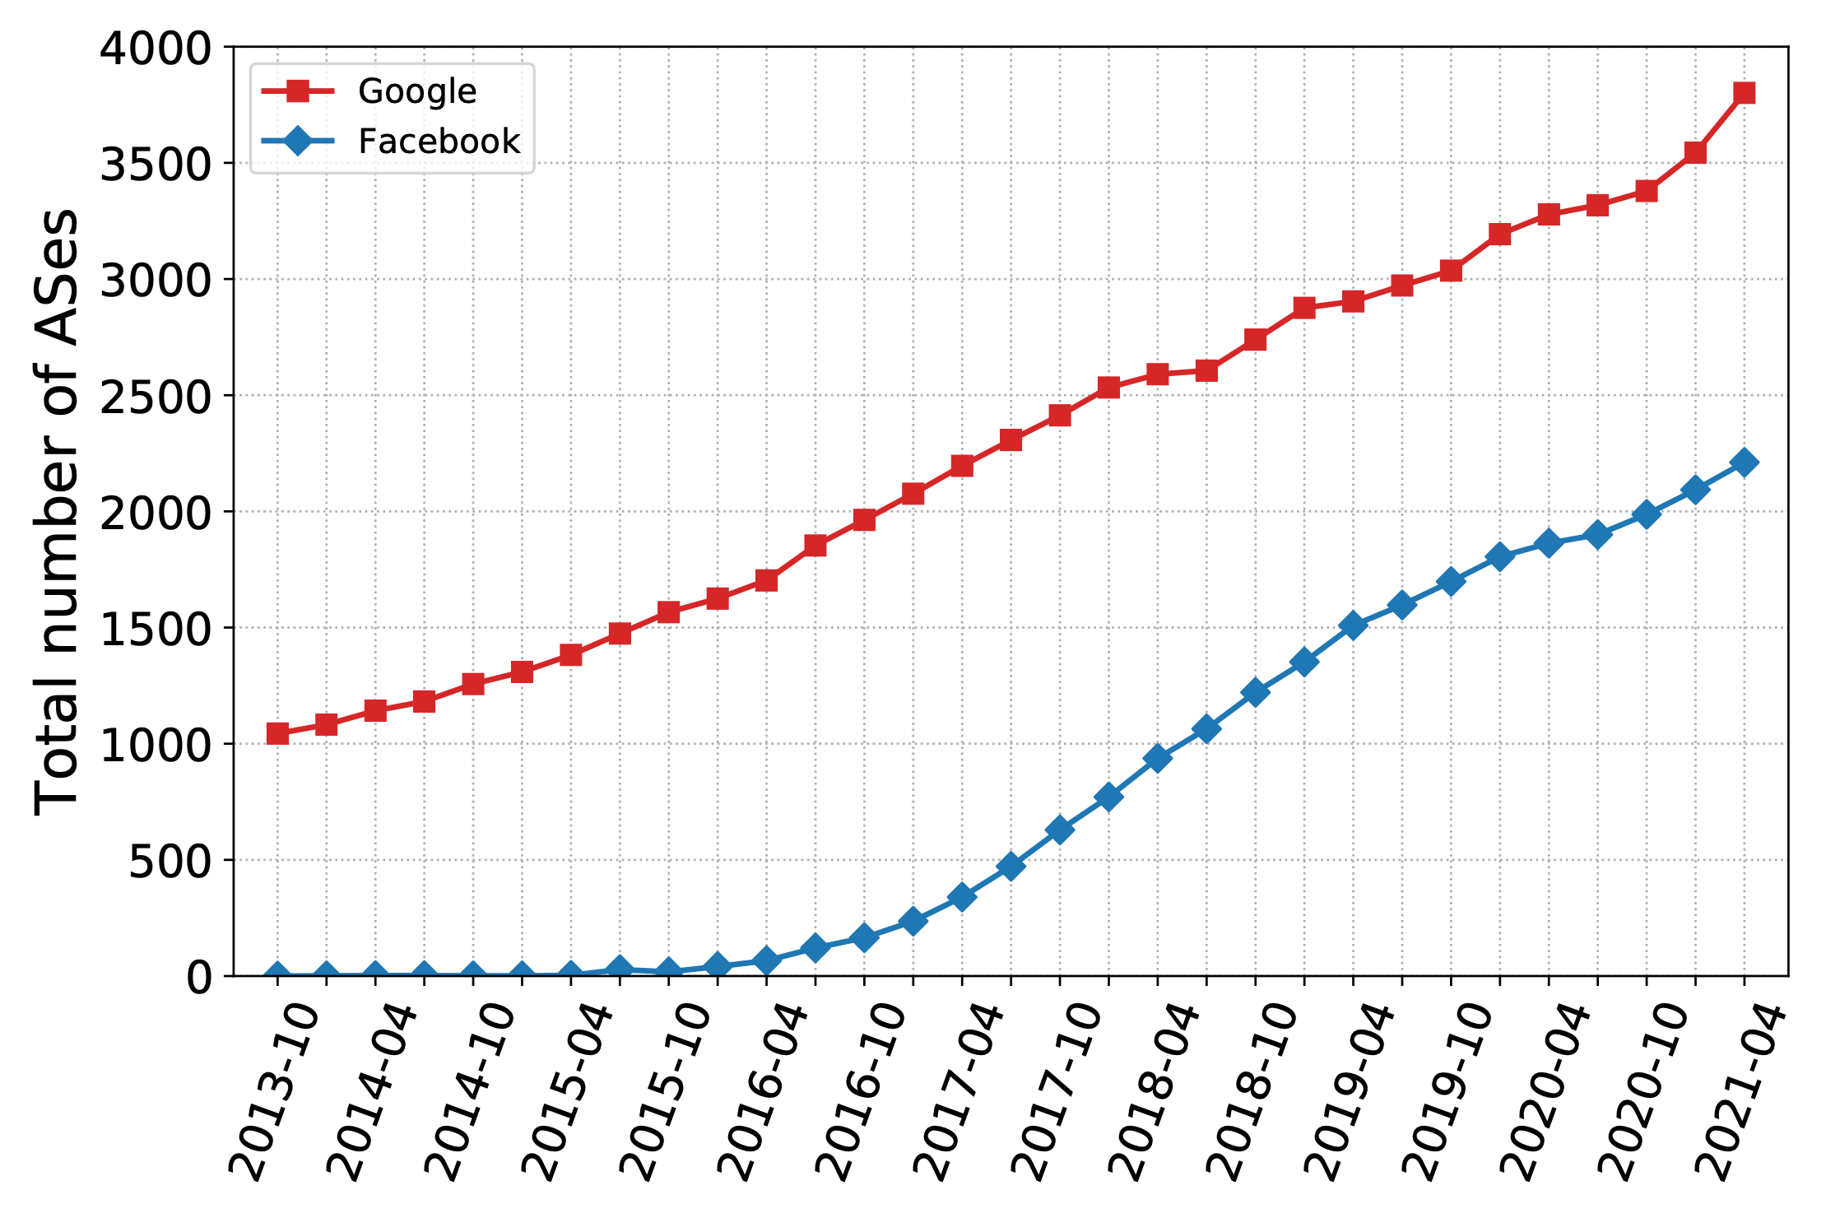
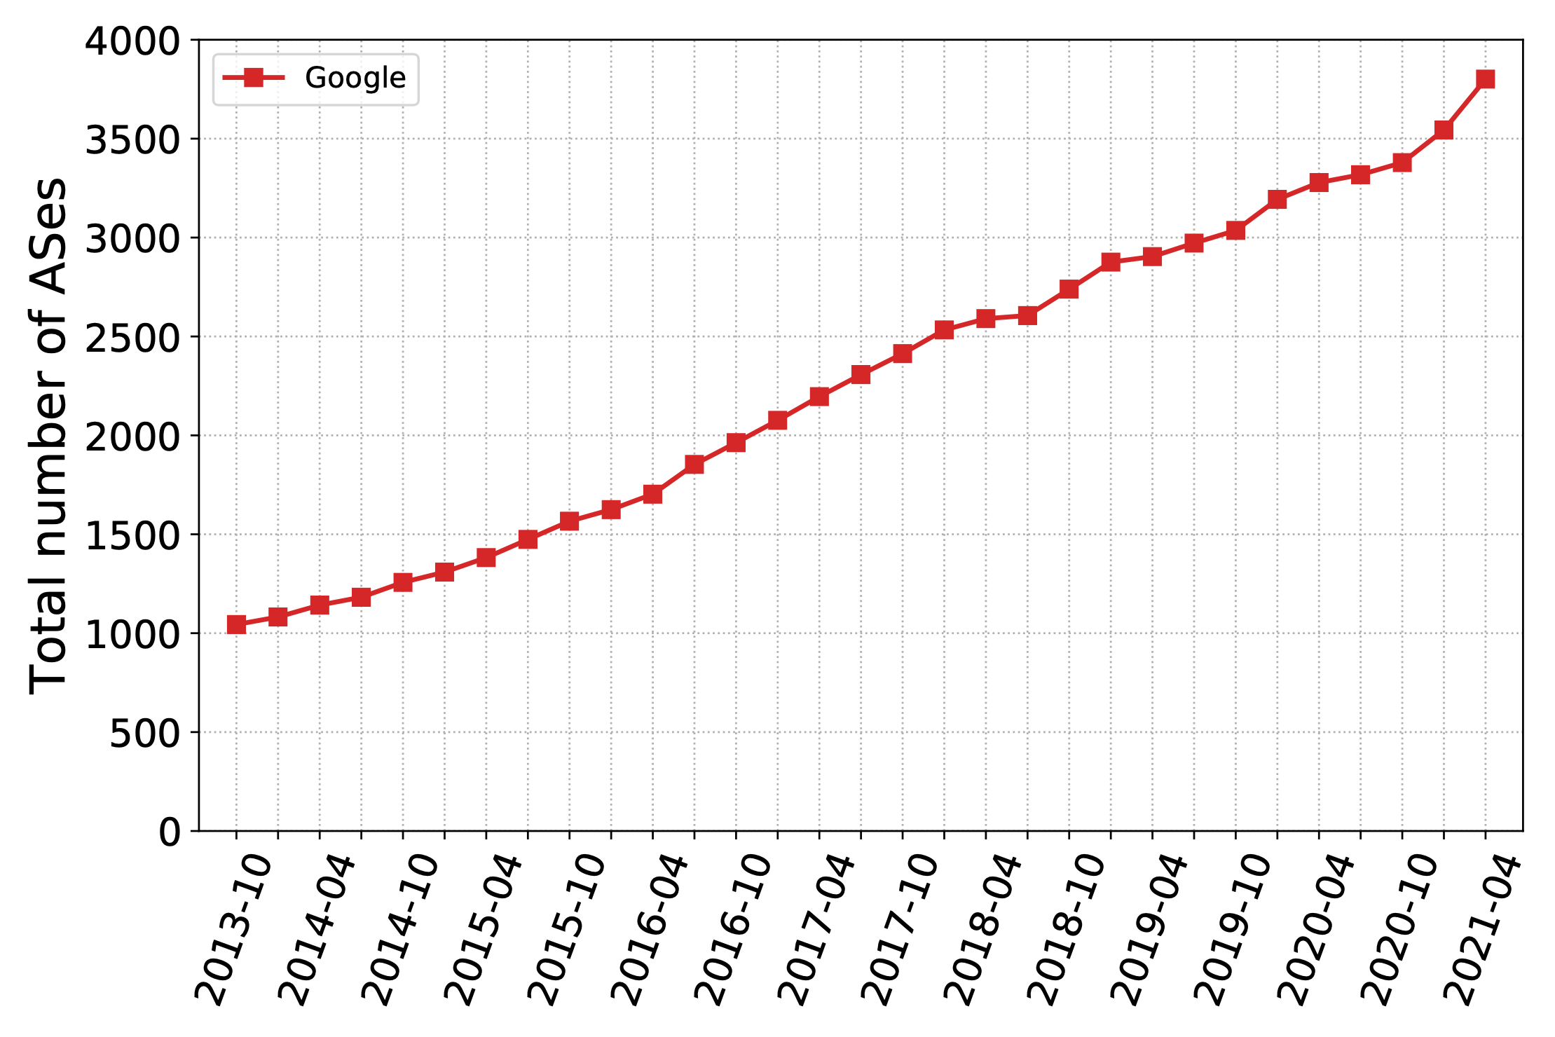
Hypergiants’ off-nets Expansion
Longitudinal Growth (2013-2021)
Google has off-nets
in more than 3.8k ASes
Period Netflix switched
to only HTTP
Birth of a CDN
Off-net footprint growth for top-4 HGs (Google, Facebook, Netflix and Akamai) over time.
18

Slide 19
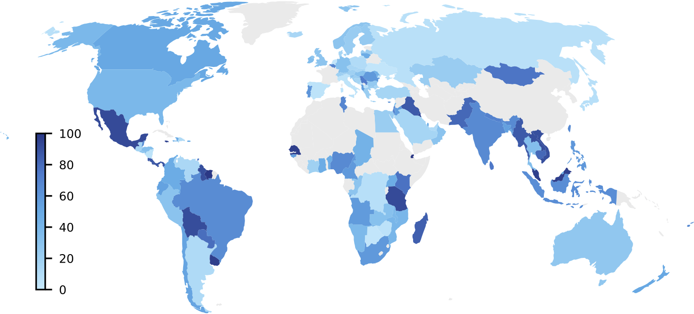
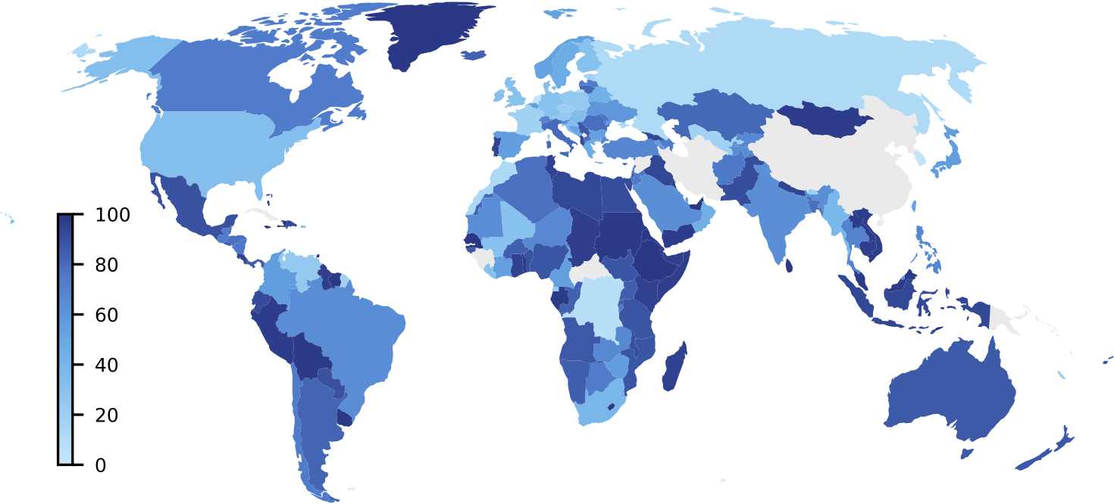
Hypergiants’ off-nets Expansion
Internet User Population Coverage over time
Mexico: 90%
46% increase in global user coverage
Mexico: 90%
Argentina: 15%
October 2017 : 34.2%
Argentina: 80%
April 2021: 49.8%
Facebook’s off-net footprint user coverage (%).
We rely on the APNIC user population coverage statistics.
Example: Facebook in 2017 announced that it had plans to expand in Africa and other developing regions.
Our analysis reflect that they achieved this goal.
19

Slide 20
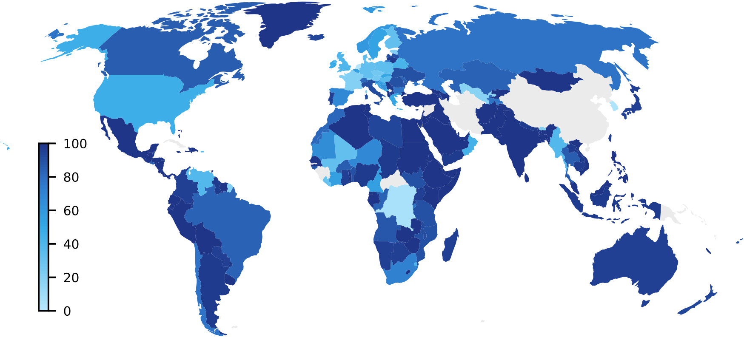
Hypergiants’ off-nets Expansion
Internet User Population Coverage based on customer cone
27% increase in global user coverage
Google
Netflix
Include Customer Cone : 63.2%
April 2021: 49.8%
Exclude Customer Cone : 49.8%
% of a country’s Internet users including and excluding the customer cones of ASes hosting Facebook off-nets (April 2021).
What-If: Serving into the customer cone noticeably expands coverage in parts of Africa, Asia, Europe and South America.
20

Slide 21
Validation
Validation from Hypergiants.
Four Hypergiants replied to our survey.
All of them indicated that we correctly uncovered 89-95% of ASes hosting their off-nets.
21

Slide 22
Takeaways
Large content providers serve most of the traffic on today’s Internet. To send this traffic, some of them host off-net servers in user ASes around the world.
Generic methodology to uncover off-net deployments.
Significant growth of 3 ( , , ) out of 4 top HGs, hosted in more than 4.5k ASes.
Significant fraction of user population can be served by off-nets in their ISP.
Artifacts, datasets, and an interactive portal are available at:
https://pgigis.github.io/hypergiants-offnets/
22

